Slide 1
Week 2 Lecture
STA10003 FOUNDATIONS OF STATISTICS
Jascha Zimmermann
jzimmermann@swin.edu.au
Notes:
Need song for this week!
https://www.youtube.com/watch?v=37Qsqd8mw9o
Cold Chisel! – 1980 -ITA
Put up until recording starts …
In each lecture, we will do a brief revision of what we talked about last week.
But before we do that …

Slide 2



Indigenous Acknowledgment
Swinburne University of Technology recognises the historical and cultural significance of Australia’s Indigenous history and the role it plays in contemporary education.
Each day, every Australian walks on what was once traditional Indigenous land. I acknowledge the traditional custodians of the land I currently occupy, the Wurundjeri people.
We acknowledge and respect the Traditional Owners of all the lands across Australia, their cultures and heritages. We pay our respects to the Ancestors, Elders past, present and emerging. We recognise the continuing sovereignties of all Aboriginal and Torres Strait Islander Nations.
Notes:
"In recognising the importance of education, Swinburne University also recognises the importance of Australia's Indigenous history and culture to our every day lives. As such, an acknowledgment of traditional custodians is a relevant and important way to connect to that history and culture”.

Slide 3
Overview
Revision of Week 1
Frequency Distributions
Tables / Graphs / Percentiles / Boxplots …
PAUSE – Part 2
Measures of Central Tendency
Mean / Median / Mode …
Output from SPSS
Descriptive Statistics and Graphs
Which Analysis? / Which Procedure?
Notes:
Today we’re going to look at things like:
Levels of Measurement of Variables:
including information about the
Descriptive statistics and Graphs
We’ll have a look at some of the
Output SPSS
and how we can use these when
Describing Distributions
We also need to decide
Which Analysis? / Which Procedure?
to use. This depends on the level of measurement of our variable …
We’ll then finish up with
What’s Normal?
And how we decide that ...

Slide 4
Part 1: Week 1 Revision & Frequency Distributions
STA10003 Week 2

Slide 5
Revision of Week 1
Terminology:
Population:
All of the ‘things’ we are interested in
Can be people, households, car manufacturers, trains ...
Difficult to measure the entire population
Sample:
A subset of the population
Must be representative of the population if we want to infer our finding to the general population of ‘things’ [population of interest]
Variable:
Overarching label of the element / feature we want to measure
Gender / Ethnicity / Age …
Notes:
Last week, we talked about the importance of critically thinking about the statistics that we hear. How much stock should we take of them? Are they good – or bad stats?
We also looked at what a population might be. In statistics, when we refer to populations we might be talking about people. But equally, we might be talking about objects or events.
A population is all of the ‘things’ that we are interested in. If we are wanting to find out the proportion of Melbourne trains that run late, what would our population be? … ALL Melbourne trains.
Because it is difficult to measure the entire population of ‘things’ when conducting a study, we usually use a sample. This sample, however, must be representative of the population of interest if we want to infer our findings to that particular population.
If we wanted to undertake a study of the population of Australia, there is no real use in using a sample of STA10003 students. Although you are part of that population, you are not truly representative of it. We wouldn’t be including any very young people, or any older people.
When we conduct studies, we use variables to measure whatever it is we want to measure. Last week we talked about the height [which is the variable] of female STA10003 students [the population of interest].
We also looked at proportions and percentages, so let’s just do some quick calculations …

Slide 6
Revision of Week 1
Thinking critically about statistics:
Bias: [selection bias / information bias]
Need to AVOID bias – otherwise our findings cannot be inferred to the population
To avoid bias – think critically about:
How was our sample selected?
Use random sampling where possible
How were our questions asked?
Avoid emotional language / leading questions
Who sponsored / conducted the study?
Is the source reliable / credible?
Notes:
If our study is biased in ANY way, we cannot infer our findings to our population. We might get some useful information, but it only represents information about our sample.
To avoid bias, we need to think about how our sample was selected. The best way is to use a random sample, whereby every ‘thing’ in our population has an equal chance of being included.
We also need to ensure that we avoid emotional language or leading questions.
And we should think about who sponsored the study, and who conducted the study – and how reliable or credible we think they are. A study undertaken by the Research and Development team at Coca-Cola will probably find that Coke tastes better than Pepsi ...

Slide 7
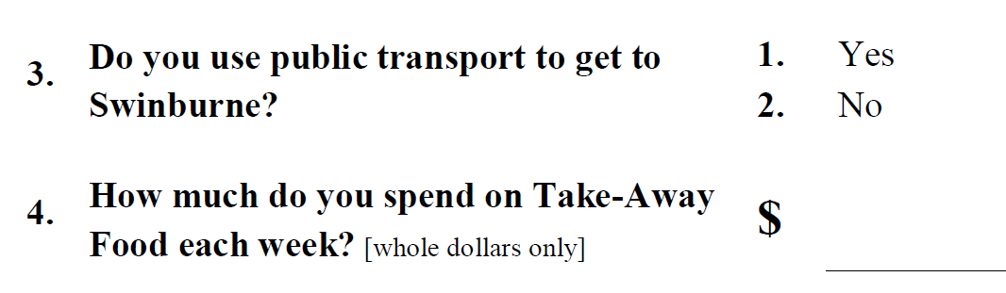
Revision of Week 1
Thinking critically about statistics:
Notes:
If our study is biased in ANY way, we cannot infer our findings to our population. We might get some useful information, but it only represents information about our sample.
To avoid bias, we need to think about how our sample was selected. The best way is to use a random sample, whereby every ‘thing’ in our population has an equal chance of being included.
We also need to ensure that we avoid emotional language or leading questions.
And we should think about who sponsored the study, and who conducted the study – and how reliable or credible we think they are. A study undertaken by the Research and Development team at Coca-Cola will probably find that Coke tastes better than Pepsi ...

Slide 8
Revision of Week 1
IF the sample has been selected in an unbiased way, AND the measurements / questions are unbiased, THEN we can use our sample to tell us something about a population.
IF either the sample selection or the measurements are biased THEN the sample doesn’t tell us ANYTHING meaningful about a population.
An unbiased sample could be used to tell us something about a different population.
Notes:
To summarise,
IF the sample has been selected in an unbiased way,
AND the measurements / questions are unbiased
THEN we can use our sample to tell us something about the population
IF either the sample selection or the measurements are biased
THEN the sample doesn’t tell us ANYTHING about the population
That’s it for the revision, so let’s look at an overview of today’s lecture ...

Slide 9
Learning Outcomes
By the end this week make sure you:
understand how proportions and percentages are calculated
understand how central tendency is measured and calculated
understand how to describe and summarise a categorical and metric variable
can identify a categorical and metric variable in SPSS
can produce and interpret output for categorial and metric variables in SPSS

Slide 10
FREQUENCY DISTRIBUTIONS
A frequency distribution offers a way of organising our variable measure into categories [or intervals of values]
provides an organized ‘picture’ of the data
presented in either tabular or graphical form
Frequency Tables:
Can be grouped / ungrouped AGE
20-29, 30-39, 40-49 / 24, 32, 38, 41, 43, 47
Frequency Graphs:
Histogram / Polygon / Boxplot [metric data]
Bar Chart [SPSS terminology] / Pie Chart [categorical data]
Notes:
It presents the set of categories or values that make up the original measurement scale
It also gives a record of the frequency, or number, of individuals in each category

Slide 11
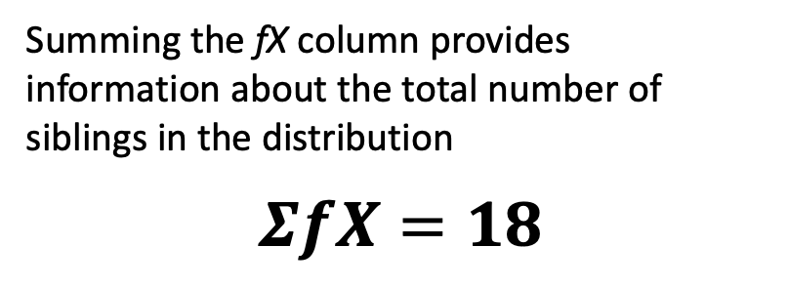
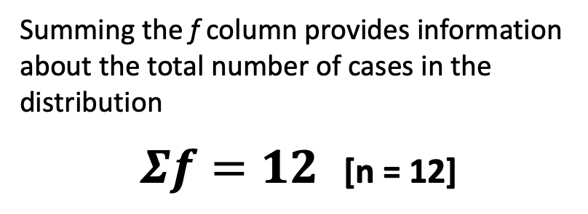
FREQUENCY DISTRIBUTIONS
Ungrouped Frequency Table:
Each category or distinct values has it’s frequency recorded
usually …
First column lists categories / intervals [X]
Second column lists the frequency [f]
… additional columns are sometimes included [sum of frequencies / proportions / percentages]
Summing the f column provides information about the total number of cases in the distribution
$Σf=12$ [n = 12]
Number of siblings [X] | f | fX
0
1
2
3
4
5
Number of siblings [X] | f | fX
0 | 3
1 | 5
2 | 1
3 | 2
4 | 0
5 | 1
Number of siblings [X] | f | fX
0 | 3 | 0
1 | 5 | 5
2 | 1 | 2
3 | 2 | 6
4 | 0 | 0
5 | 1 | 5
Summing the fX column provides information about the total number of siblings in the distribution
$$ΣfX=18$$

Slide 12
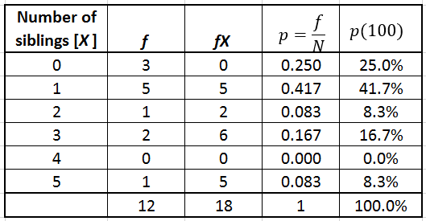
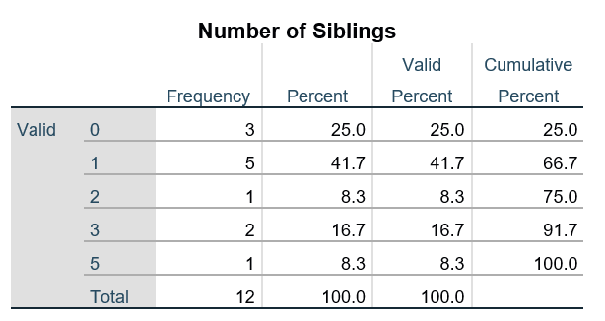
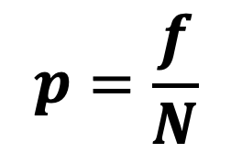
FREQUENCY DISTRIBUTIONS
Ungrouped Frequency Table:
Frequency Table
Frequency Table [SPSS]
$$p=\frac{f}{N}$$

Slide 13
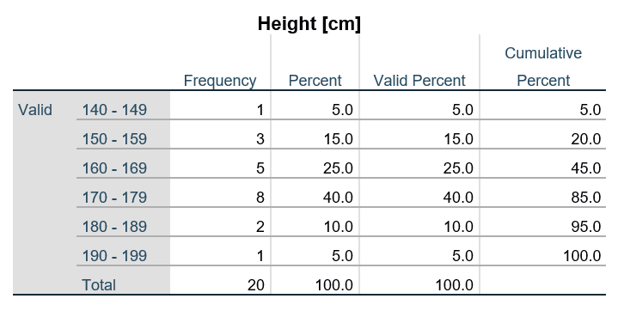
FREQUENCY DISTRIBUTIONS
Grouped Frequency Table:
Each interval or ‘band of values’ has it’s frequency recorded
Width of interval should be simple number [eg 2, 5, 10]
Lower score in each interval should be a multiple of the width [eg 10-19, 20-29, 30-39]
No gaps or overlapping values …
Frequency Table
Frequency Table [SPSS]
Height in cm [X] | f
140 - 149 | 1
150 - 159 | 3
160 - 169 | 5
170 - 179 | 8
180 - 189 | 2
190 - 199 | 1

Slide 14
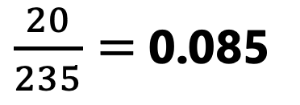
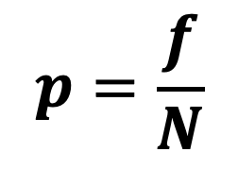
Proportion / Percentage calculations
Some data was collected [tutorial survey] on the predominant handedness of students who attended the first tutorial.
Out of 235 students, 20 are LEFT handed.
What proportion are left handed?
What is the percentage?
$\frac{20}{235}=$0.085
0.085*100 = 8.5%
$$p=\frac{f}{N}$$
Notes:
In the tutorials last week, we collected some information from you. One piece of information we collected was about your predominant hand. Let’s work out the proportion and percentage of left handed people.
Out of the 235 students who returned their survey, 20 are Left-handed:
20 / 235= 0.085 = 8.5%
That’s quite interesting – and we’ll use this information in future lectures!
Just a few more calculations before we go any further …

Slide 15
Proportion / Percentage calculations
Out of 307 students enrolled in the unit, 238 attended the first tutorial.
233 students provided information relating to gender identification. Of those who provided this information, 125 identified as female.
238 / 307= .775 = 77.5% of enrolled students attended the first tutorial
125 / 233 = .536 = 53.6% of students identified as female
Notes:
Out of 369 students enrolled in the unit, 290 attended the first tutorial
238 / 307= .775 = 77.5% of enrolled students attended the first tutorial
Of those who attended the first tutorial, 233 students provided information relating to gender identification and 125 identified as female
125 / 233 = .536 = 53.6% identified as female
Of the 20 predominantly left-handed people, 12 are female [the 20 comes from the previous slide …]
12 / 20 = .600 = 60.0% of the left-handed people are female
Of the 108 males who attended the first tutorial, 8 are left-handed
8 / 108 =.074 = 7.4% of the males who attended the first tutorial are left-handed
If we add 125 females and 108 males, we end up with 233 – so not the 238 students who attended the first tutorial as stated on this slide. Why is there a difference? On the tutorial survey, we had 4 categories: 1 Male / 2 Female / 3 Non-Binary and 4 Prefer not to say. We were only using 2 of the 4 categories …
Last week we also spent some time talking about bias …

Slide 16
Proportion / Percentage calculations
Of the predominantly left-handed people, 12 identified as female.
Of the 108 male students who attended the first tutorial, 8 are left-handed.
12 / 20 = .600 = 60.0% of the left-handed people are female
8 / 108 =.074 = 7.4% of the males who attended the first tutorial are left-handed
Notes:
Out of 369 students enrolled in the unit, 290 attended the first tutorial
238 / 307= .775 = 77.5% of enrolled students attended the first tutorial
Of those who attended the first tutorial, 233 students provided information relating to gender identification and 125 identified as female
125 / 233 = .536 = 53.6% identified as female
Of the 20 predominantly left-handed people, 12 are female [the 20 comes from the previous slide …]
12 / 20 = .600 = 60.0% of the left-handed people are female
Of the 108 males who attended the first tutorial, 8 are left-handed
8 / 108 =.074 = 7.4% of the males who attended the first tutorial are left-handed
If we add 125 females and 108 males, we end up with 233 – so not the 238 students who attended the first tutorial as stated on this slide. Why is there a difference? On the tutorial survey, we had 4 categories: 1 Male / 2 Female / 3 Non-Binary and 4 Prefer not to say. We were only using 2 of the 4 categories …
Last week we also spent some time talking about bias …

Slide 17
Levels of Measurement of Variables
Metric Variables are those that we can measure or count reasonably accurately
Height in cm, Temperature in degrees Celsius, Number of siblings
Categorical Variables are those we classify by putting them into groups
Gender, Nationality, Location, Diet
Some variables can be measured either on a Metric or Categorical basis
Age: years [metric] / young or old [categorical] Income: $ [metric] / low, medium or high [categorical]
Notes:
Metric Variables are those that we can measure or count reasonably accurately
[eg height in cms, temperature in degrees Celsius, Milligrams, etc]
Categorical Variables are those we classify by putting them into groups
eg gender – male or female / gender identification groupings; location – might be coded as inner city, suburban or rural area;
diet – low fibre or high fibre,
Some variables can be measured either on a Metric or Categorical basis
[eg age – years [metric] / young or old [categorical]
Income - $ [metric] / low, medium or high [categorical]
Whether a variable is measured on a Categorical or Metric basis can determine what analysis technique we can use.
With our computer program – SPSS – we need to first enter our raw data …

Slide 18
Levels of Measurement of Variables
SPSS uses numbers to code categorical variables
0 = Male / 1 = Female
CATEGORICAL variables
the numbers are arbitrary
1 = Male / 2 = Female OR 1 = Female / 2 = Male
METRIC variables:
the numbers mean something real
age = 55 years
Notes:
This program only uses numbers, so we need to code categorical variables.
With CATEGORICAL variables the numbers are arbitrary
eg 1 = Male / 2 = Female
In our tutorial 1 survey, we used the usual convention of 1, 2, 3, etc., for the categorical variables, but we can use any numbers of our choosing.
IF I happened to follow a particular AFL Team, I might want to use a players’ jersey numbers:
41 Levi Casboult
35 Ed Curnow
30 Charlie Curnow [or as I refer to him – Baby Curnow]
It really doesn’t matter what numbers you assign to the categorical variables, but it is important that these are clearly allocated in the ‘back end’ of SPSS …
With METRIC variables the numbers mean something real
eg age = 55 years
Let’s have a look at what the data file might look like …

Slide 19
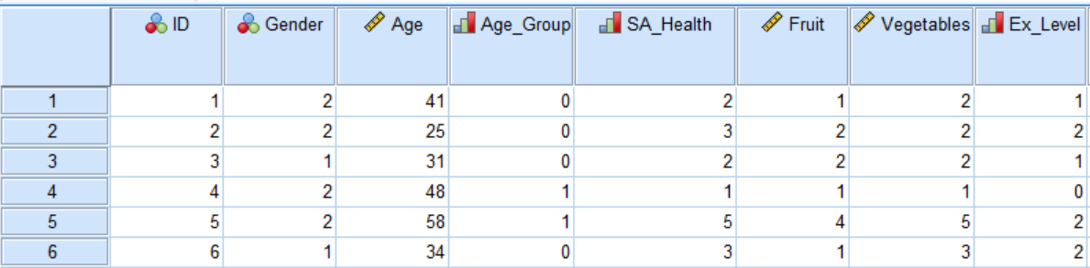
SPSS Data File
Once we have some information we can input it into an SPSS data file:
Data File: Fruit_Veg_&_Exercise_Data.sav
Notes:
This is a snapshot of our Fruit_Veg_&_Exercise_Data.sav data file. We use this one fairly regularly, so you’ll get used to seeing it.
The very first column [solid blue column] is the case number assigned by SPSS. Each case contains all of our raw data for one person. We have given each case an ID number, and this is the same as the case number. This is mainly for sorting purposes.
If we look at case number 1, it has an ID number of 1, Gender of 2, age is 41, their age group is zero, their Self-Assessed Health Status is 2, and so on across the row. All this information is about one person.
But what we’re really interested in – at this point – is understanding what all of these numbers actually mean!
Note that the variable names across the top also show the ‘measure’. This is what was assigned when the data file was originally set up – but we need to be careful when using this information …
Looking at the ‘Ex Level’ column we can see that Exercise Level is measured as 0, 1 or 2, but at this point we can’t tell which number refer refers to what.
We have two variables referring to age. One looks like it’s in years, and the other shows an Age Group … but we don’t know what the 0 or 1 means here.
We’ll be looking both Metric and Categorical variables today and we’ll start with the Categorical variable of EX_Level. We can then work out what type of information we can obtain. So from this partial look at the data file, we can see that the variable of Ex_Level has at least 3 value labels …

Slide 20
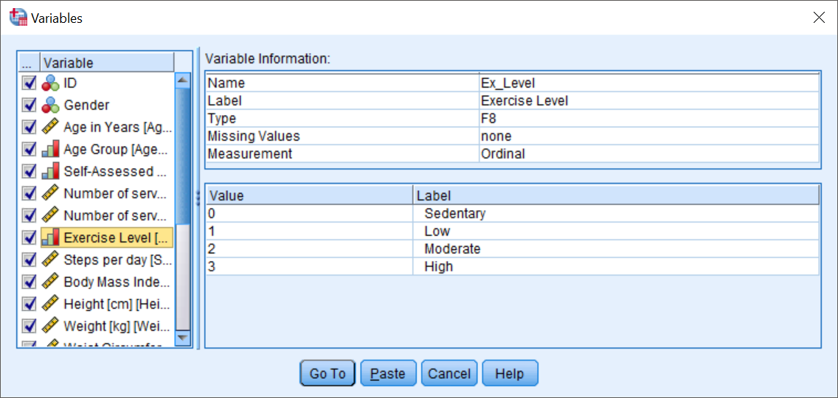

SPSS OUTPUT – Categorical Variables
When looking at categorical variables in SPSS, we need to check how the categories have been labelled:
Data File: Fruit_Veg_&_Exercise_Data.sav
Notes:
When we enter our Categorical variables into SPSS, we need to label our categories – and we did this for some of our Tutorial 1 survey last week. Once we have done that, we just need to click a button to see this information. We’ll be covering the practical side in the tutorials, so I’m just showing you what you will actually see.
For the Exercise Level variable, we can now see that the numbers are from 0 to 3, and have been coded as:
0 = Sedentary
1 = Low;
2 = Moderate; and
3 = High
The numbers, as I said, are purely arbitrary.
I might want to use some of the player’s jersey numbers to label my values – particularly if I didn’t think I’d be sharing the data file … but I understand that not everyone follows Carlton …
Because the numbers are arbitrary, it is really important that the value labels are added – so that anyone else using the data set can understand the codes.
We can use the variable icon – and this is also shown under the Utilities drop-down.
To get an overall view of our variable …

Slide 21
SPSS OUTPUT – Categorical Variables
We use the Frequency procedure to obtain output for our Categorical variables:
Exercise Level
 |  | Frequency | Percent | Valid Percent | Cumulative Percent
Valid | Sedentary | 710 | 35.5 | 35.5 | 35.5
 | Low | 610 | 30.5 | 30.5 | 66.0
 | Moderate | 428 | 21.4 | 21.4 | 87.4
 | High | 252 | 12.6 | 12.6 | 100.0
 | Total | 2000 | 100.0 | 100.0
Data File: Fruit_Veg_&_Exercise_Data.sav
Notes:
… we use the Frequencies procedure – for Categorical data - to get our table of percentages for Ethnicity.
If we hadn’t given value labels to our variables, instead of the Australian, Northern Europe and so on, on the left-hand side of the table, SPSS would have just listed the numbers from 1 to 4 and we still wouldn’t be any the wiser as to what they meant.
The numbers listed under FREQUENCY are the raw data. In this particular data set, we have 444 people, 286 of whom identified as Australian born.
The next column [Percent] tells us that the 286 Australian born people equals 64.4% of our entire data set. But this figure can be a bit confusing, because it takes into account ALL of our data set. We’ve got missing values [coded as system missing – which means that we didn’t have information about these people]. It tells us that 2 people, or 0.5%, of all of the people in the data set did NOT answer the question.
We are just interested in those that did, so we really should ignore the ‘Percent’ information - although if lots of people didn’t answer a particular question, it may tell us that our question wording was ambiguous. So the missing data can be quite useful – sometimes.
So, it is the Valid Percent column that is of most interest to us. Here the Australian born people equates to 64.7% of all of the people who actually answered the question. So it only takes into account the 442 people who told us their ethnicity.
The Cumulative Percent just adds the Valid percents together. For example, 86.4% of the people in our data set were born in either Australian or Northern European. 95.0% are either Australian, Northern European or Southern European. The cumulative percent doesn’t really give us a lot of useful information, so:
In this unit, the most important column in this table is the Valid Percent.
As well as giving us a Frequency table, we can also ask SPSS to produce graphical representations for this variable.
And it looks like this …

Slide 22
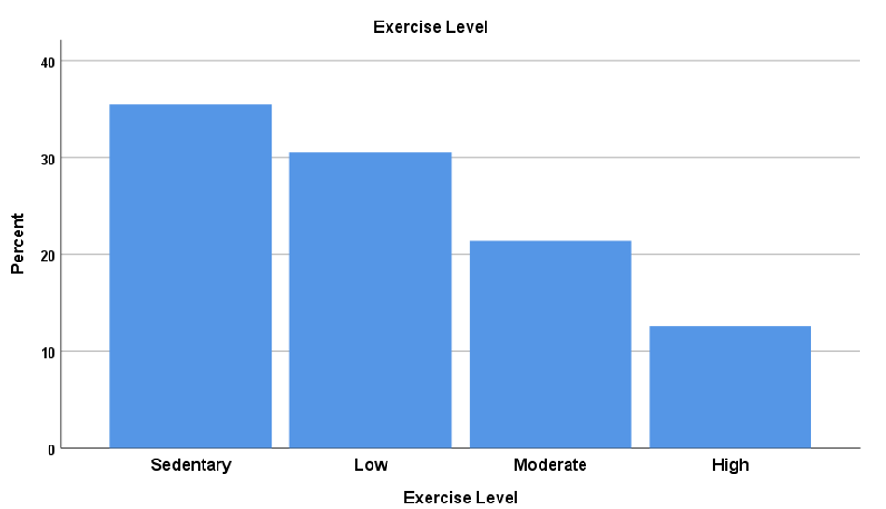
SPSS OUTPUT – Categorical Variables
Bar Chart
The graphical representation for Categorical Variables in reports is the Bar Chart [called Bar Graph in text]
Notes:
For Categorical variables, we can ask for a Pie Chart or a Bar Chart, and I’d like you to tell me which is easier to read.
The Bar Chart is very clear. It’s quite obvious that the most typical exercise level is sedentary!
You can see this on the Pie Chart, but it gets harder to see the categories that are closer together in size. It can be really hard to read – especially if we have one category with 30.5% and another with 35.5% for instance.
Although the Pie Chart looks quite pretty in colour, if there are any more than 2 or 3 categories, it can become very messy. We can modify the charts to include value labels …
For the purposes of this unit, the preferred graphical representation for Categorical Variables is the Bar Chart.
As all of our categories are lined up next to one another, it tends to make it easier to see small differences.
Let’s now look at how SPSS treats METRIC variables ...

Slide 23
SPSS Data File
Data File: Fruit_Veg_&_Exercise_Data.sav
Notes:
Again we’re using the Fruit_Veg_&_Exercise_Data.sav data file.
We use the Explore procedure to obtain descriptive statistics for METRIC variables.
We’ll use the example of the Hours Spent Watching TV per day …

Slide 24
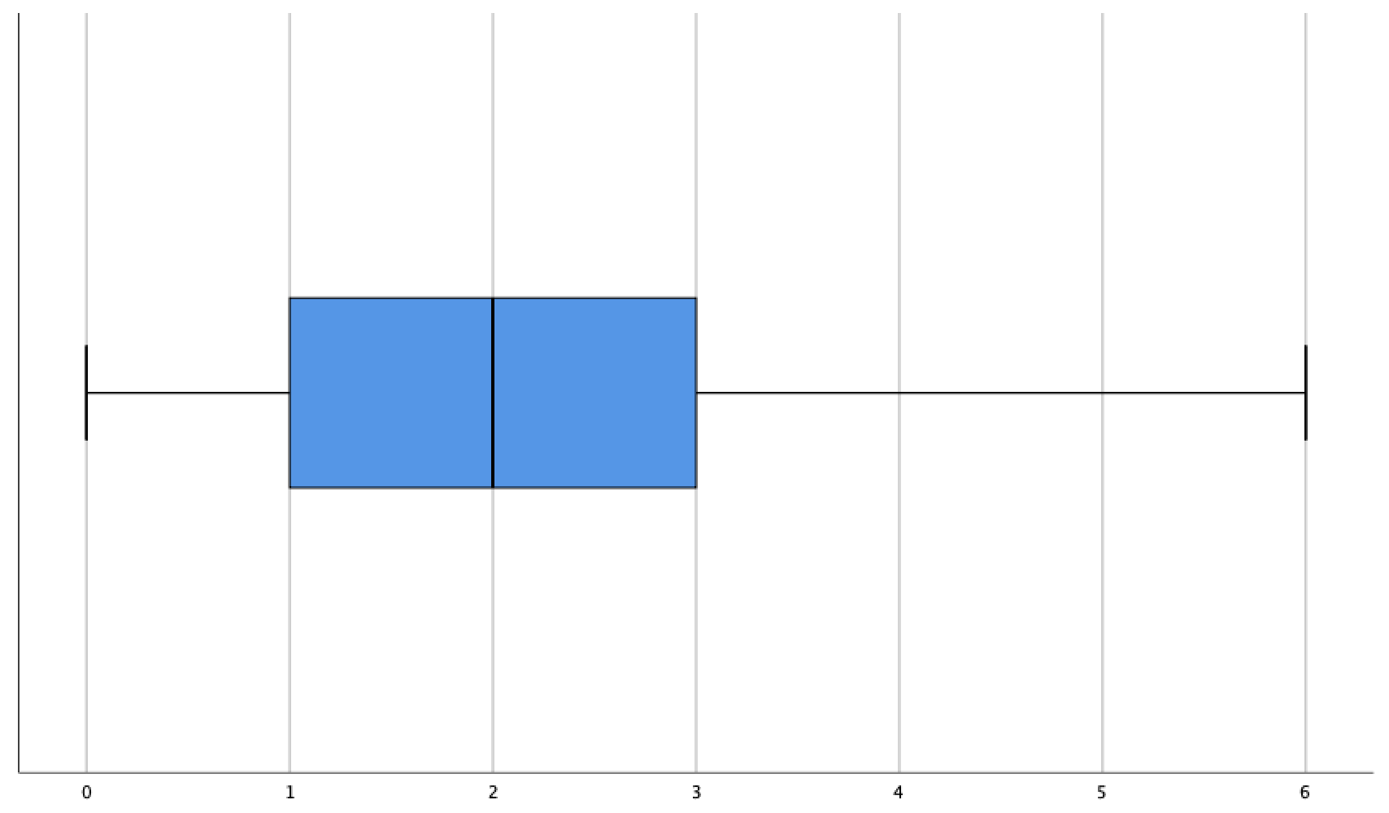
SPSS Graphs – Metric Variables
We use the Explore procedure to obtain output for our Metric variables:
Boxplot
Notes:
For Categorical variables, we can ask for a Pie Chart or a Bar Chart, and I’d like you to tell me which is easier to read.
The Bar Chart is very clear. It’s quite obvious that the most typical exercise level is sedentary!
You can see this on the Pie Chart, but it gets harder to see the categories that are closer together in size. It can be really hard to read – especially if we have one category with 30.5% and another with 35.5% for instance.
Although the Pie Chart looks quite pretty in colour, if there are any more than 2 or 3 categories, it can become very messy. We can modify the charts to include value labels …
For the purposes of this unit, the preferred graphical representation for Categorical Variables is the Bar Chart.
As all of our categories are lined up next to one another, it tends to make it easier to see small differences.
Let’s now look at how SPSS treats METRIC variables ...

Slide 25
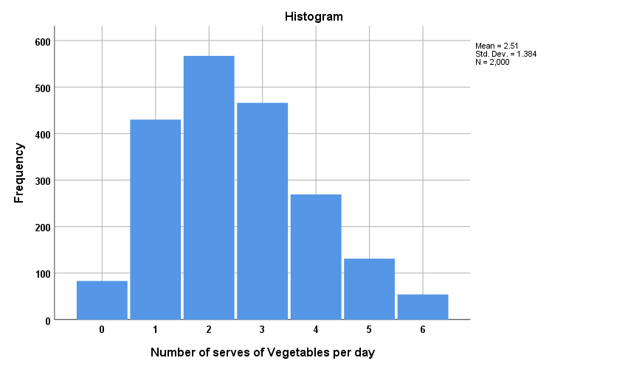
SPSS Graphs – Metric Variables
Histogram
The graphical representation for Metric Variables in reports is the Histogram
Notes:
For Categorical variables, we can ask for a Pie Chart or a Bar Chart, and I’d like you to tell me which is easier to read.
The Bar Chart is very clear. It’s quite obvious that the most typical exercise level is sedentary!
You can see this on the Pie Chart, but it gets harder to see the categories that are closer together in size. It can be really hard to read – especially if we have one category with 30.5% and another with 35.5% for instance.
Although the Pie Chart looks quite pretty in colour, if there are any more than 2 or 3 categories, it can become very messy. We can modify the charts to include value labels …
For the purposes of this unit, the preferred graphical representation for Categorical Variables is the Bar Chart.
As all of our categories are lined up next to one another, it tends to make it easier to see small differences.
Let’s now look at how SPSS treats METRIC variables ...

Slide 26
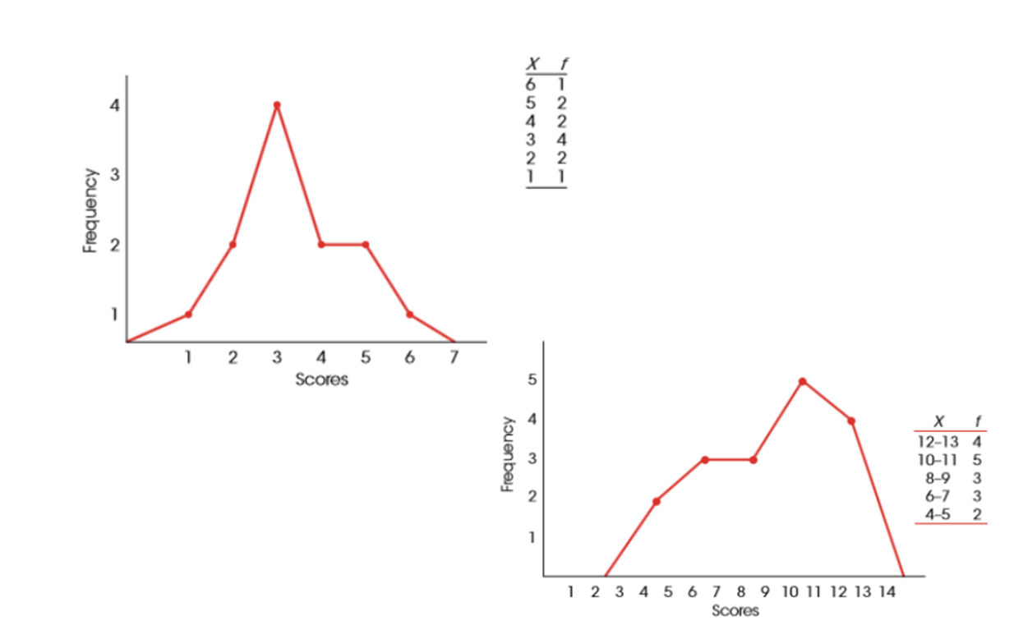
Other Types of Frequency Graphs
In a Frequency polygon, a ‘dot’ is placed above the centre of each score
The placement of the dot [height] corresponds to the frequency.
A continuous line is drawn from dot to dot to connect the series
The graph is completed by drawing a line down to the X-axis [zero frequency] at each end of the range of scores.
See Figures 2.5 / 2.6 on pages 44/5 of the text
Notes:
For Categorical variables, we can ask for a Pie Chart or a Bar Chart, and I’d like you to tell me which is easier to read.
The Bar Chart is very clear. It’s quite obvious that the most typical exercise level is sedentary!
You can see this on the Pie Chart, but it gets harder to see the categories that are closer together in size. It can be really hard to read – especially if we have one category with 30.5% and another with 35.5% for instance.
Although the Pie Chart looks quite pretty in colour, if there are any more than 2 or 3 categories, it can become very messy. We can modify the charts to include value labels …
For the purposes of this unit, the preferred graphical representation for Categorical Variables is the Bar Chart.
As all of our categories are lined up next to one another, it tends to make it easier to see small differences.
Let’s now look at how SPSS treats METRIC variables ...

Slide 27
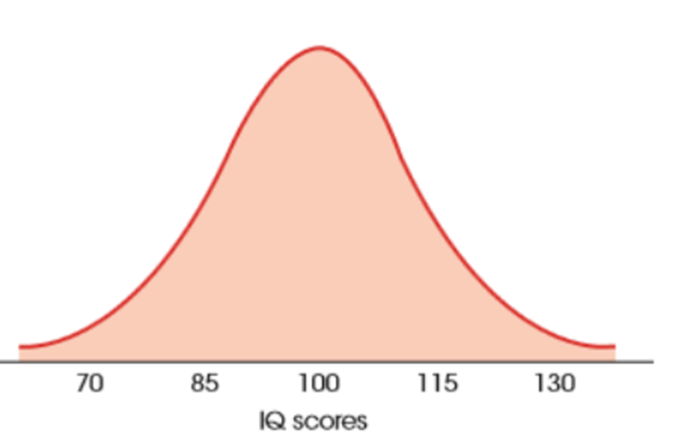
Graphs for Population distributions
Proportions [relative frequencies] are usually used in histograms and other graphs when representing data for a whole population
Smooth curves are also sometimes used in representing population distributions, in cases where the data is metric
Proportion with IQ score 100 or more?
Proportion with IQ score 121 or more?
Proportion = 0.50
Proportion = 0.08

Slide 28
Features of distributions [metric data]
Central tendency
provides us with a single ‘score’ that defines the centre of the distribution [mean / median / mode]
the values that is ‘most typical’ / ‘most representative’ of the entire group
Variability
Measures the degree to which scores are spread out / clustered together [standard deviation / IQR]
Shape
Symmetric / Skewed [positive or negative]
Extreme Scores - outliers
Any very high or low values, extreme values, unusual values
Notes:
Well look at the shape of distributions first …

Slide 29
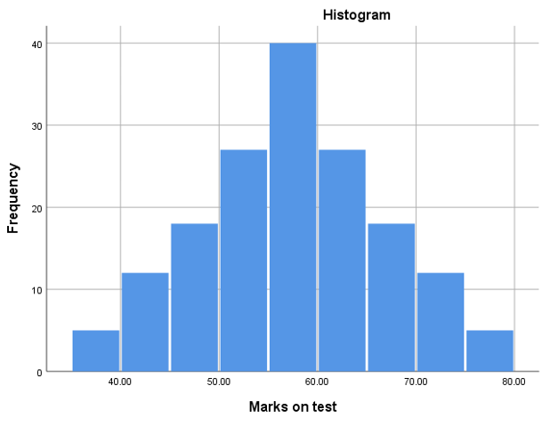
Shape of distributions [metric data]
SYMMETRIC
Left and right sides are roughly a mirror image

Slide 30
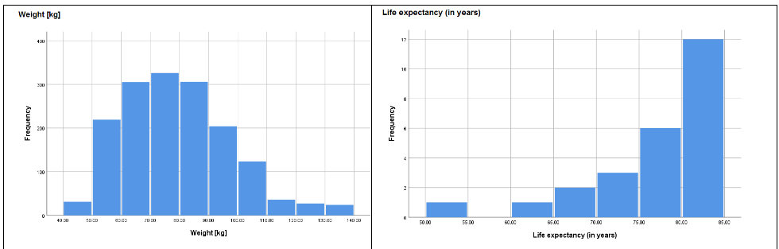
Shape of distributions [metric data]
SKEWED
Scores taper off at one end
Tail indicates the direction of the skew
Positive Skew
Negative Skew
Notes:
The House Prices histogram on the left is Positively Skewed – it tails off to the right.
Most of the house prices are around $200 000 - $300 000, with some up around $700 000, and then a ‘blip’ at just over $900 000. The statistical term for ‘blip’ is an outlier. It lies a bit too far from our mean for our liking. This can be a little difficult to see on our histograms, so we need to look carefully.
The Enthusiasm for Statistics histogram on the right is Negatively Skewed – it tails off to the left.
It looks like most people in this data set are quite enthusiastic about stats! As most of the values are at the higher end of the scale. There doesn’t seem to be any outliers here – no values that are clearly separated from the rest, but there is a tail.
When we come across skewed data, we need to think carefully about how we might report these statistics ...

Slide 31

Bombay December 9 2021

Slide 32
PAUSE
Part 2: Measures of Central Tendency
Output from SPSS
Which Analysis? / Which Procedure?

Slide 33
Part 2: Measures of Central Tendency Output from SPSS Which Analysis? / Which Procedure?
STA10003 Week 2

Slide 34
SPSS OUTPUT – Metric Variables
We use the Explore procedure to obtain descriptive statistics for our Metric variables
Descriptives
 |  |  | Statistic | Std. Error
Number of serves of Vegetables per day | Mean |  | 2.51 | .031
 | 95% Confidence Interval for Mean | Lower Bound | 2.45
 |  | Upper Bound | 2.57
 | 5% Trimmed Mean |  | 2.47
 | Median |  | 2.00
 | Variance |  | 1.916
 | Std. Deviation |  | 1.384
 | Minimum |  | 0
 | Maximum |  | 6
 | Range |  | 6
 | Interquartile Range |  | 2
 | Skewness |  | .455 | .055
 | Kurtosis |  | -.273 | .109
Data File: Fruit_Veg_&_Exercise_Data.sav
Notes:
These descriptive statistics summarise some of the important features of the data set.
The numbers that we’re most interested in this Foundation unit have been highlighted – and I might jump around a little bit here.
Firstly, the mean. This is the number of hours spent watching TV averaged over the data set. In this data set, we asked people to tell us how many hours TV they watched per day.
Some people said 2, other 4, 3 and so on. If we want to manually calculate the mean, we just add all those numbers together, and then divide by the total people in our sample. So if I just had the times for these three people and wanted to calculate the mean, I would add 2 + 4 + 3 = 9, and then divide by 3 – the total number in this sample to get an average [or mean] of 3 hours of TV. [Do this calculation on the board].
This can be quite simple when we only have a few numbers to deal with, but in this data set we had 444 people, so it can be rather tedious to calculate – and my math’s isn’t that great. Luckily SPSS takes care of this for us.
The minimum is the lowest figure – in this case zero hours of TV, and the maximum is the highest – 8.5 hours per day.
The standard deviation tells us how far from the mean our values are, and is calculated by using the square root of the variance.
So, if the standard deviation is 2, the variance is 4. If the standard deviation is 3, the variance is 9. In this example, the square root of 2.287 is 1.5123 – you can check this on a calculator if you like!
But what actually is the variance? What does it tell us?
It tells us the spread of the data by calculating how much each individual score differs from the mean. It squares the differences and averages them.
I’m not going to go into detail here. If you want to see the workings of the formula, it’s on page 18 of the Text.
We don’t use the variance figure in First Year Stats. We focus on the standard deviation, as one of our measures of spread.
Before moving on, let’s just do a quick hand calculation of the mean and standard deviation …

Slide 35
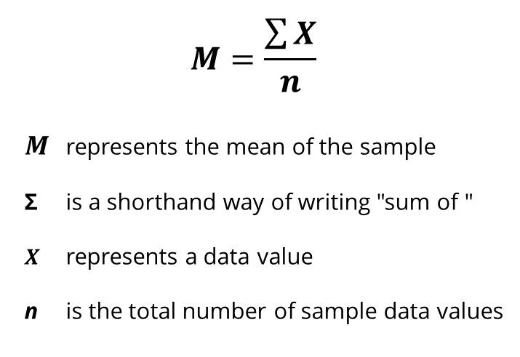
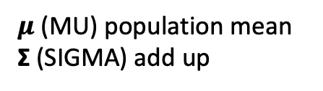
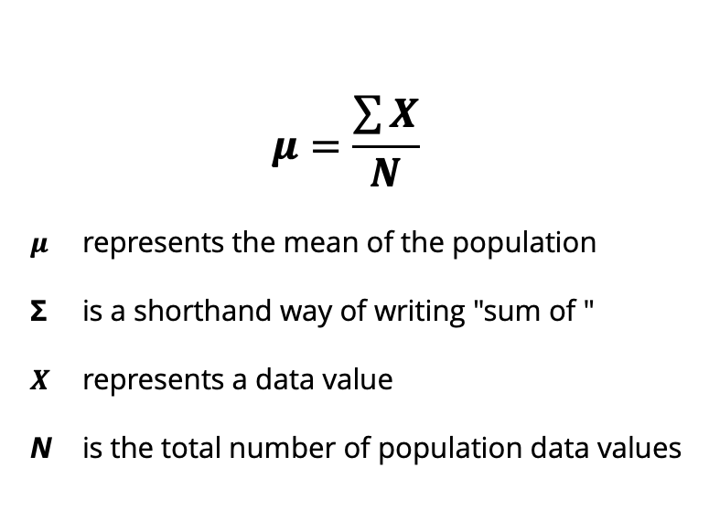
Formula for calculation of the mean
The mean for a distribution is the sum of the scores divided by the number of scores
Population Mean calculation:
Sample Mean calculation:
$$μ=\frac{\sum{X}}{N}$$
$μ$ represents the mean of the population
Σ is a shorthand way of writing "sum of "
$X$ represents a data value
N is the total number of population data values
$$M=\frac{\sum{X}}{n}$$
$M$ represents the mean of the sample
Σ is a shorthand way of writing "sum of "
$X$ represents a data value
n is the total number of sample data values
$μ$ (MU) population mean
Σ (SIGMA) add up
Notes:
Here we introduce some notation.
Go through slide …

Slide 36
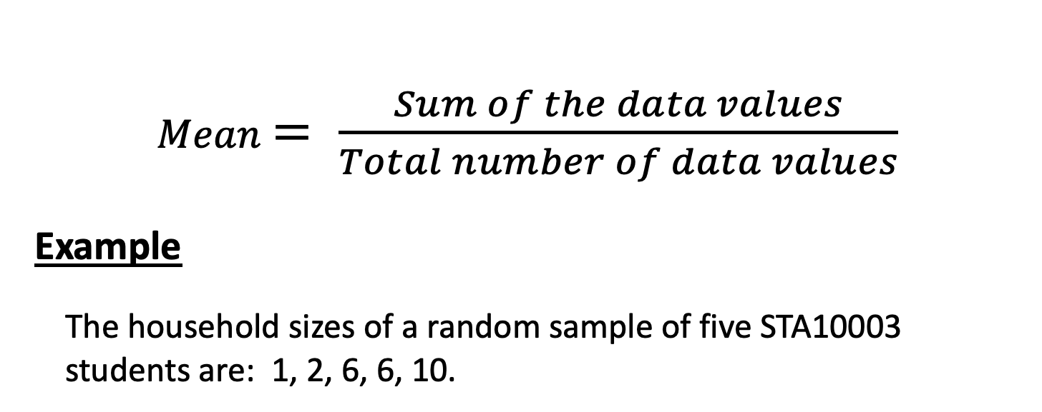
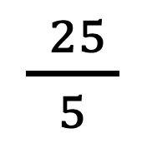
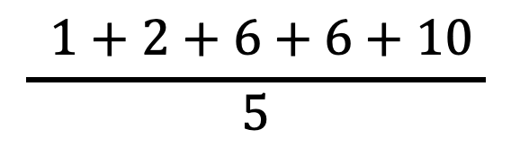
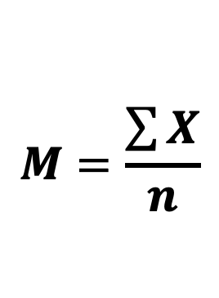
Calculation of the mean
$Mean$ $= \frac{Sum of the data values}{Total number of data values}$
Example
The household sizes of a random sample of five STA10003 students are: 1, 2, 6, 6, 10.
$$M=\frac{\sum{X}}{n}$$
$$\frac{ 1+2+6+6+10 }{5}$$
$\frac{ 25 }{5}$
M = 5
Notes:
So, the mean equals the sum of all of the data values divided by the total number of data values.
4 + 3 + 8 = 15 divided by 3, mean = 5
Our average household size is 5 people.
Not only do we want to be able to see what the average size is, we can use another formula to calculate the standard deviation, that is, how spread out the data is …

Slide 37
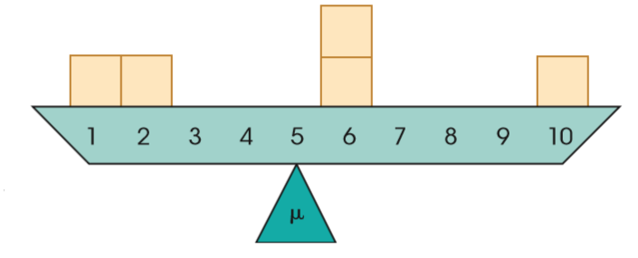
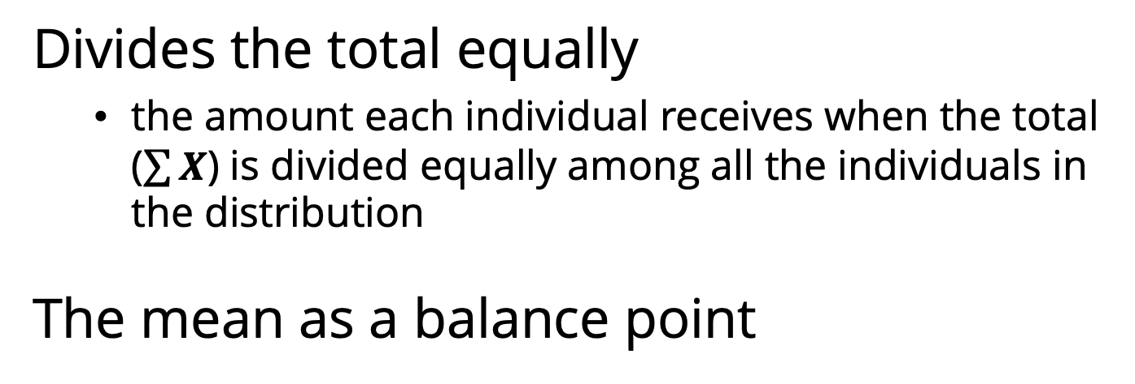
Interpretation of the mean
Divides the total equally
the amount each individual receives when the total ($\sum{X}$) is divided equally among all the individuals in the distribution
The mean as a balance point
6
1
2
6
10
Σ_{distances} = −4, −3 = −7
Σ_{distances} = 1, 1, 5 = 7
Notes:
Simplify- probably say some of this verbally only

Slide 38
Characteristics of the mean
Every score in the distribution contributes
every score adds to the total (ΣX) and every score contributes one point to the number of scores (n)
changing the value of any score will change the mean
adding a new score to a distribution, or removing an existing score, will usually change the mean
The exception is when the new score [or the removed score] is exactly equal to the mean
X=1, 2, 6, 6, 10
ΣX=25 n=5
M=5
X=1, 2, 5, 6, 6, 10
ΣX=30 n=6
M=5

Slide 39
Characteristics of the mean
Every score in the distribution contributes
if a constant [same] value is added to every score in a distribution, the same constant will be added to the mean
Similarly, if you subtract a constant from every score, the same constant will be subtracted from the mean
if every score in a distribution is multiplied [or divided] by a constant value, the mean will change in the same way
X=1, 2, 6, 6, 10
ΣX=25 n=5
M=5
X=(1+1), (2+1), (6+1), (6+1), (10+1)
X=2, 3, 7, 7, 11
ΣX=30 n=5
M=6
X=1, 2, 6, 6, 10 M=5 Multiply every X by 2
X=2, 4, 12, 12, 20
ΣX=50 n=5 M=10

Slide 40
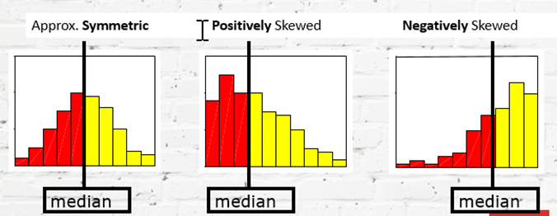
The median
the median provides us with the location of the midpoint in the distribution
divides the distribution into two equal parts
50% of values are at or above the median
50% of values are at or below the median
50%
50%
50%
50%
50%
50%
Notes:
With the first histogram which is approximately symmetric, we would use the mean – the average – as our measure of centre.
For example, we would say something like:
“In this sample, the average number of hours of TV watched per day was 4 hours”.
When we have skewed data, whether Positive or Negative, it is more appropriate to use the median as our measure of centre, because the median is the middle number. It divides our distribution into two equal halves, and is less affected by any outliers or long tail.
Using the median as the measure of centre would require a change to the statement we can make about the distribution.
Let’s just use the Hours of TV watched analogy to look at the interpretation of the median …

Slide 41
Calculating the median
First, order the data from lowest to highest.
If there are an odd number of values, the median is the middle value.
If there are an even number of values, the median is the average of the middle two values.
Example: heights: 167, 205, 181, 172, 168, 153
153 167 168 172 181 205
Median = 168
Median = 170
Notes:
Go through bit about ordering.
For very small data sets, it can be quick and convenient to calculate the median by hand. For larger data sets though, it is more convenient to use a computer package such as SPSS.
In this example, sorted data for the variable of height becomes 153, 167, 168, 172, 181, 205.
There are an even number of values so the median is the average of the middle two values (168 and 172), therefore the median is 168 + 172 = 340 divided by 2 = 170
To summarise ...

Slide 42
Comparing the mean and median
The mean can be defined as the “balance point” for a distribution because the distances above the mean must have the same total as the distances below the mean
The median defines the middle of the distribution in terms of scores

Slide 43
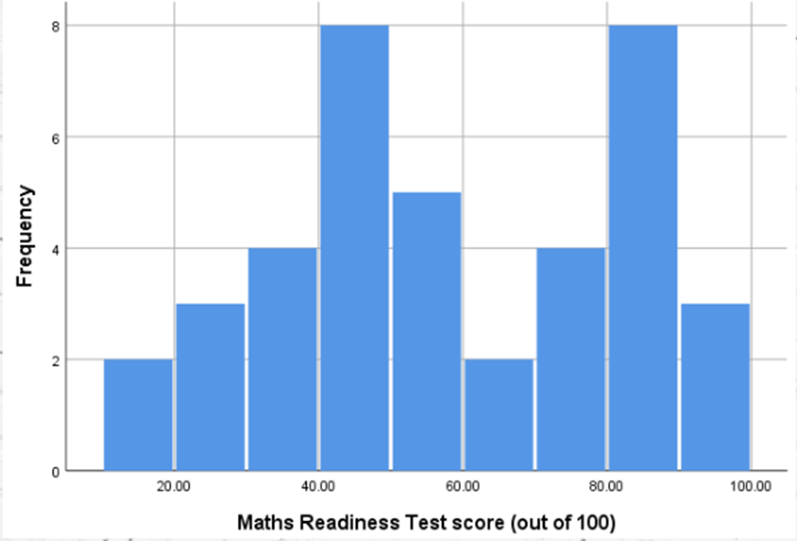
The mode
In frequency distributions, the mode is the score [or category] that has the greatest frequency
The mode can be a useful measure of central tendency as it corresponds to an actual score in the data
the mean and the median are both calculated values and often produce an answer that does not equal any score in the distribution
Although a distribution will have only one mean and only one median, it is possible to have more than one mode.
A distribution with two modes is said to be bimodal, and a distribution with more than two modes is called multimodal.

Slide 44

The mode
Used as the appropriate measure of central tendency for categorical data
only measure for nominal scale
can be useful for ordinal … but median is more so!
The most typical [most common] level of exercise was ‘Sedentary’.

Slide 45
Comparison of mean and median
If a distribution is reasonably symmetric, the values of the mean and median will be similar.
If a distribution is skewed, the mean will be pulled in the direction of the skew. The mean will also be affected by any outliers [extreme scores].
The mean is most appropriate for reasonably symmetric distributions with no outliers.
The median is most appropriate for skewed distributions, or distributions with outliers.
Notes:
Go through slide.
As another example …

Slide 46
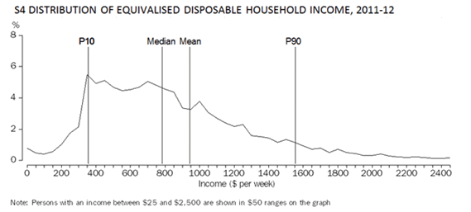
Comparison of mean and median
$379
$790
$918
$1555
50%
50%
Positively Skewed
10%
90%
90%
10%
Source: Australian Bureau of Statistics, 2013, Catalogue Number 6523.0
Household Income and Income Distribution, Australia, 2011-12, Summary of Findings
http://www.abs.gov.au/ausstats/abs@.nsf/Latestproducts/6523.0Main%20Features22011-12?opendocument&tabname=Summary&prodno=6523.0&issue=2011-12&num=&view=
Notes:
This is some Australian Bureau of Statistics information for disposable household income.
The income estimates are adjusted by equivalence factors to standardise the estimates with respect to household size and composition, while taking into account the economies of scale that arise from the sharing of dwellings.
ABS reports the median as $790 and the mean as $918 per week.
Therefore, the distribution is positively skewed.
The median is more representative of typical weekly household income as the mean has been affected by those households with unusually high incomes.
Another way to convey information about the distribution is to use the Percentiles Table.
In the graph shown here, P10 represents the 10th percentile of $379 and P90 is the 90th percentile of $1555.
A person with household income of $379 per week, sits at the lower end of the range. Only 10% of households have an income lower than that.
We can also use the percentiles table to place ourselves in the distribution – so back to our hours of TV and our SPSS output ...

Slide 47
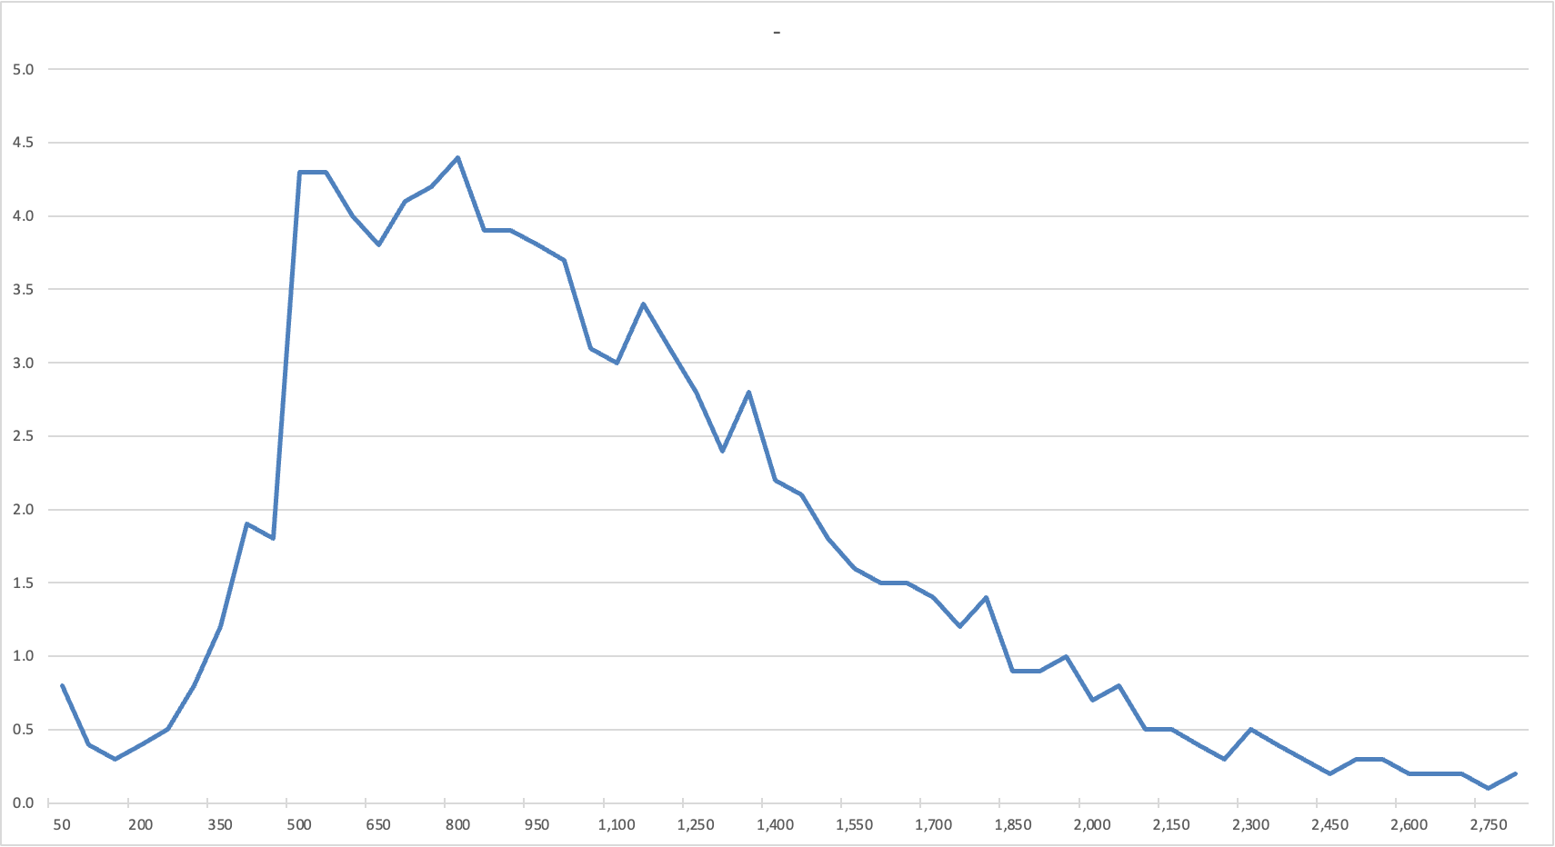
Distribution of household income per week 2019-2020
P10 $510
Median $959
P90 $1950
Mean $1124
50%
50%
Source: Survey of Income and Housing, 2019-2020, Australian Bureau of Statistics, Household Income and Wealth, Australia 2019-2020 financial year.

Slide 48
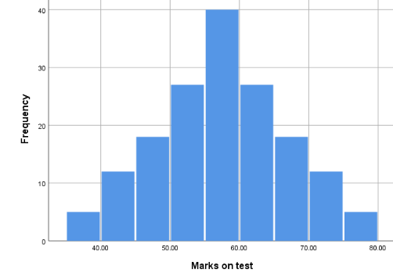
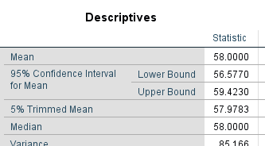
Symmetric[al] distributions
For a distribution that is approximately symmetric, the right-hand side is a mirror image of the left-hand side
the median is at the centre [midpoint]
the mean is at the centre [balance point]
if the distribution has only one mode, it will also be in the centre of the distribution
mean

Slide 49
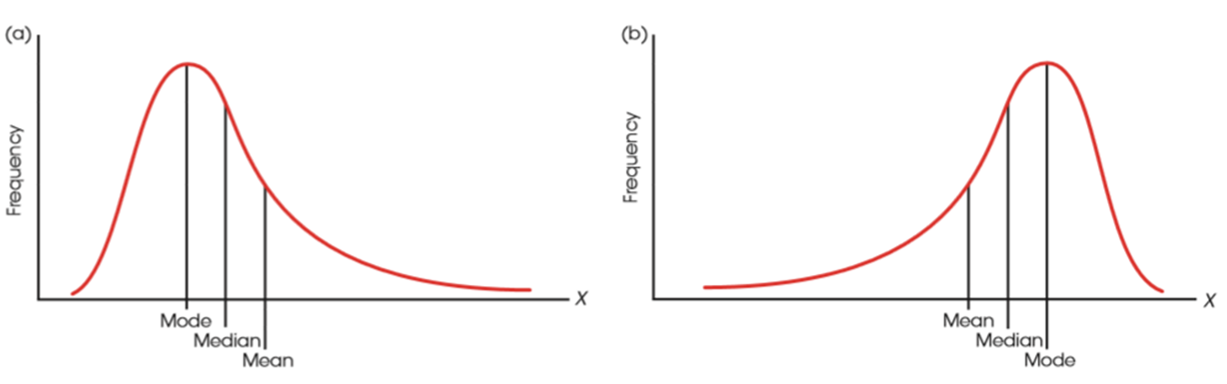
Skewed distributions
In skewed distributions, especially distributions for continuous variables, there is a tendency for the mean, median, and mode to be located in different positions
In a positively skewed distribution, the most likely order of the three measures of central tendency from smallest to largest (left to right) is the mode, median, and mean
In a negatively skewed distribution, the most probable order is mean, median, and mode
median
median
see Figure 3.12 [p93]
Notes:
Refer back to slide 27 …
Another way to convey information about the distribution is to use the Percentiles Table.

Slide 50
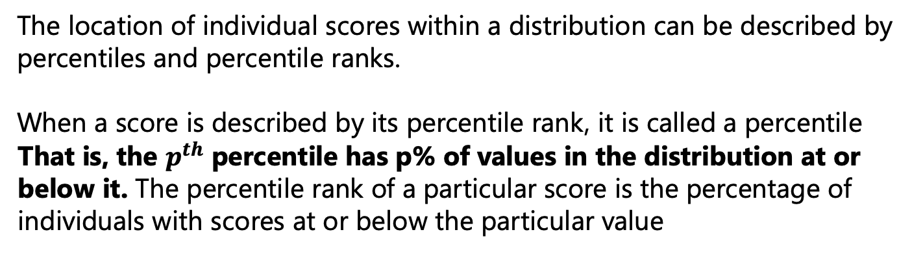
Percentiles and Percentiles Ranks
The location of individual scores within a distribution can be described by percentiles and percentile ranks.
When a score is described by its percentile rank, it is called a percentile
That is, the $p^{th}$ percentile has p% of values in the distribution at or below it. The percentile rank of a particular score is the percentage of individuals with scores at or below the particular value
Approximately 16% of adults have an IQ score of 85 or less
Therefore, an IQ score of 85 is the 16th percentile
Therefore, an IQ score of 85 has a percentile rank of 16%
Approximately 84% of adults have IQ scores of 115 or less
Therefore, an IQ score of 115 is the 84th percentile Therefore, an IQ score of 115 has a percentile rank of 84%
Notes:
SPSS produces a percentiles table [when we request it] – which allows us

Slide 51
Percentiles and Cumulative Frequency distributions
Percentiles and percentile ranks can be calculated by counting the number of scores that are in or below each category on the scale
X | f | cf | c%
6 | 1 | 20 | 100%
5 | 2 | 19 | 95%
4 | 3 | 17 | 85%
3 | 8 | 14 | 70%
2 | 4 | 6 | 30%
1 | 2 | 2 | 10%
Values between 3.5 and 4.5
From this table, it appears that 85% of values in this distribution are less than or equal to 4 – but 4 is the rounded off value
Actual values could be anywhere between 3.5 and 4.5 … so the 85th percentile is 4.5
Note: Cumulative Percentile ranks / Interpolation outside scope of unit [refer pp.50-55 if want further details]
Notes:
SPSS produces a percentiles table [when we request it] – which allows us

Slide 52
Percentiles Table [SPSS] – Metric Variables
median
Percentiles
 |  | Percentiles
 |  | 5 | 10 | 25 | 50 | 75 | 90 | 95
Weighted Average (Definition 1) | Number of serves of Vegetables per day | 1.00 | 1.00 | 1.00 | 2.00 | 3.00 | 4.00 | 5.00
Tukey's Hinges | Number of serves of Vegetables per day |  |  | 1.00 | 2.00 | 3.00
Percentiles:
the percentage of people in the sample that measured at or less than the specified value.
eg 5% of people eat one or less than one serve of vegetables per day
Median is the 50th percentile
Data File: Fruit_Veg_&_Exercise_Data.sav
Notes:
This is the percentiles table produced using SPSS.
The percentiles represent the percentage of respondents in the sample who measured at or less than the specified value.
In this example, we can say that 5% of people eat one or less than one serve of vegetables per day ...
The median sits at the 50% percentile.
We can use this information to ‘place ourselves’ in the distribution.
We use the Percentiles mostly to indicate typical values in the sample.
And we commonly use the middle 50%, - which is also referred to as the Interquartile Range – to indicate the typical.
Just as the median split the distribution into two equal halves (50% watch less than 4 hours per day or 50% watch 4 or more hours per day), the quartiles splits the distribution into four parts.
Lower than 25%, between 25% and 50%, between 50% and 75%, and between 75% and 100%.
Using the middle 50% - the Interquartile Range or the IQR – is more useful than using the Range – which uses the Maximum minus the Minimum, because it is not affected too much by the presence of outliers.
So in the TV hours example, using the middle 50%, we can say that ‘typically’, people watch between 3 and 5 hours of TV per day. This is much more informative than stating the value of the IQR 5 – 3 = 2 …
We can also use the Box Plot to give us this information.
When calculating figures for the Box Plot, all of the values are re-ordered from lowest to highest ...

Slide 53
SPSS OUTPUT – Metric Variables
Lowest value Minimum
Q1 25th
Q3 75th
Highest value Maximum
Q2
50th Median
0 1 1 1 1 1 1 2 2 2 2 2 2 2 2 3 3 4 4 5 6
Percentiles
 |  | Percentiles
 |  | 5 | 10 | 25 | 50 | 75 | 90 | 95
Weighted Average (Definition 1) | Number of serves of Vegetables per day | 1.00 | 1.00 | 1.00 | 2.00 | 3.00 | 4.00 | 5.00
Tukey's Hinges | Number of serves of Vegetables per day |  |  | 1.00 | 2.00 | 3.00
Data File: Fruit_Veg_&_Exercise_Data.sav
Notes:
Here we can see that Q1 [1 serve] matches the 25th percentile, Q2 the 50th percentile or the median, and Q3 the 75th percentile.
So there are various places in the SPSS output that gives us the same information. Note, however, that the percentiles table does NOT give us the minimum and maximum values. These we can get from our descriptives table or by looking at our box plot …

Slide 54
SPSS OUTPUT – Metric Variables
Lowest value Minimum
Q1 25th
Q3 75th
Highest value Maximum
Q2
50th Median
0 1 1 1 1 1 1 2 2 2 2 2 2 2 2 3 3 4 4 5 6
Lowest value
Q2 (Med)
Highest value
Positively Skewed
50%
50%
Q1
Q3
Data File: Fruit_Veg_&_Exercise_Data.sav
Notes:
Here we can see that Q1 [1 serve] matches the 25th percentile, Q2 the 50th percentile or the median, and Q3 the 75th percentile.
So there are various places in the SPSS output that gives us the same information. Note, however, that the percentiles table does NOT give us the minimum and maximum values. These we can get from our descriptives table or by looking at our box plot
So the Boxplot information provides us with the 5 number summary [Minimum / Q1 / Q2 or Median / Q3 / Maximum
SPSS also indicates with either a circle or asterisk any extreme values …

Slide 55
99.30%

Slide 56
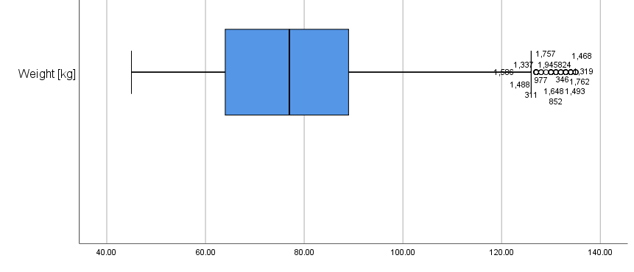
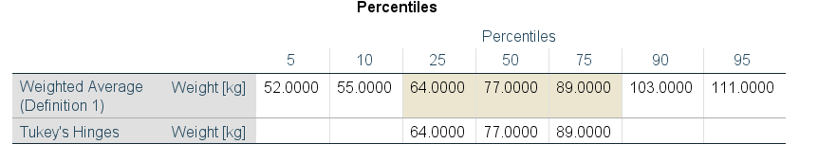
SPSS OUTPUT – Metric Variables
Lowest value Minimum
45kg
Q1
25th
64kg
Q3
75th
89kg
Highest value Maximum
135kg
Q2
50th / Median
77kg
32
58
IQR = Q3-Q1 = 89-64 = 25
Q1-37.5=26.5
IQR*1.5 = 37.5
Q3+37.5=126.5
Data File: Fruit_Veg_&_Exercise_Data.sav
Notes:
The circles indicate that these values are higher than the rest … but calculated extreme values. We do need to be aware of these as if the value is separated from the rest of the other values, we would consider this as an extreme value [outlier].
If an asterisk is shown [and we’ll come across some of these], this is a calculated extreme value. By this I mean that the value indicated by the asterisk is calculated as being at least 1.5 times the IQR above Q3 or below Q1. So the IQR is the ‘box’ and any value 1.5 times this above or below are outliers.
Using boxplots is useful if we are trying to make ‘educated comparisons’ of information. Consider ...

Slide 57
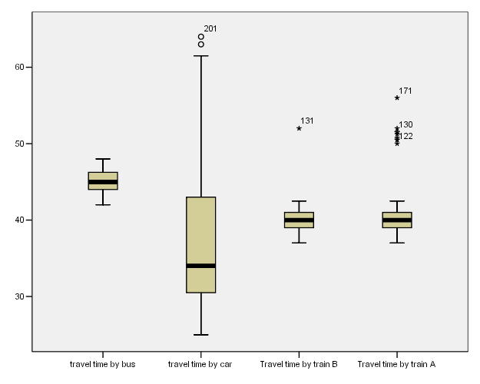
Comparing Distributions
BUS
CAR
TRAIN B
TRAIN A
Notes:
The Box Plots show us the ‘5 number Summary’ for each of our travel times for the various modes of transport fairly clearly - particularly when they are shown together like this.
When we ask for Box Plots, SPSS puts the labels at the bottom of the graph - with the plots shown vertically. I tend to rotate them so that they are sitting horizontally on top of one another rather than beside one another. It’s a personal thing, and we’ll show you how to do this in the tutorials should you prefer it in this format.
I’d like you to spend a few minutes chatting amongst yourselves about the distributions, and to come up with YOUR preferred mode of transport – based on the output shown.
Think about the 5 number summary statistics when comparing the box plots, and what figures we might need to compare …
[Give them 3 or 4 minutes to do this].
Who would prefer to take the Bus? Why?
What about the Car? Why?
Train B? Why?
Train A? Why?
When comparing the distributions, we need to think about a number of things, and some of these will just be personal preference!
Let’s look at them individually for a moment.
The BUS takes about 45 minutes most of the time – I’m looking at the median here, and it’s less varied – less spread out than the others. The bus takes somewhere between about 41 minutes [the minimum] and 48 minutes [the maximum].
The CAR takes a shorter amount of time than the bus most of the time [median around 34 minutes or so], but it can blow out to over an hour.
Trains A and B usually take roughly the same time [about 40 minutes], but Train A seems to suffer more problems than Train B if we look at the number of outliers.
In this instance, I have used the median and the minimum and maximum figures, but we should also take the middle 50% into account because this is the ‘typical’ travel times.
I have used the median, even though the Bus Box Plot looks symmetric. This is because when we are comparing distributions we want to be comparing the same thing, and as the car is certainly skewed we should go for the median. The two trains also have outliers, so the median is the best measure here too.
But is there really one of the transport modes that is better than the others? It depends …
And it can depend on any number of things.
Do we want consistency in travel times?
If so, then perhaps the bus might be the best even though it takes longer that the trains - we can be reasonably confident about the length of travel time.
Do we want a shorter travel time?
Then maybe either of the trains, but we have to expect the occasional delay. Happens quite a lot with Train A.
The car doesn’t seem to have too much going for it really – shorter travel times – 50% of the time, but 50% of the time it takes longer than around 35 minutes, and it can take more than an hour.
So you can see, that by comparing the distributions, what we are really trying to do is make sense of what is going on.
We are interpreting the numbers – not just quoting them.
The output we’ve been using has been produced using SPSS, and so far we’ve looked at both Categorical and Metric variables which use different procedures to obtain the output.
But we need to tell SPSS what it is we want it to do ...

Slide 58
Which Analysis? Which Procedure?
Categorical data:
Frequencies procedure
Request Bar Chart [Bar Graph in text]
Metric data:
Explore procedure
Default for boxplot
Request percentiles table
Request histogram
Default is Stem and Leaf plot …
Notes:
For Categorical variables, we need to use the FREQUENCIES procedure, and request a Bar Chart.
For Metric variables, we use the EXPLORE procedure, and ask for the percentiles table and a histogram.
In the tutorials this week we’ll be playing with the program, and getting a feel for what we have to do.
Because SPSS uses numbers to code categorical variables, it produces information and output even if we use the Explore procedure.
It’s therefore important to be able to make sense of the output – and recognise if we have requested the incorrect information.
Here’s what I mean …

Slide 59
Exercise Level
 |  | Frequency | Percent | Valid Percent | Cumulative Percent
Valid | Sedentary | 710 | 35.5 | 35.5 | 35.5
 | Low | 610 | 30.5 | 30.5 | 66.0
 | Moderate | 428 | 21.4 | 21.4 | 87.4
 | High | 252 | 12.6 | 12.6 | 100.0
 | Total | 2000 | 100.0 | 100.0
Descriptives
 |  |  | Statistic | Std. Error
Exercise Level | Mean |  | 1.11 | .023
 | 95% Confidence Interval for Mean | Lower Bound | 1.07
 |  | Upper Bound | 1.16
 | 5% Trimmed Mean |  | 1.07
 | Median |  | 1.00
 | Variance |  | 1.061
 | Std. Deviation |  | 1.030
 | Minimum |  | 0
 | Maximum |  | 3
 | Range |  | 3
 | Interquartile Range |  | 2
 | Skewness |  | .469 | .055
 | Kurtosis |  | -.974 | .109
Which table gives us the most useful information about the distribution of exercise level?
Notes:
At the top, we have the Frequency Table for Ethnicity that we used earlier.
Remember that we used the Valid Percent column to tell us that of the people who answered the question, 64.7% of them reported being Australian born.
We obtained the Frequency Table using the Frequency procedure.
The lower part of the slide shows the Descriptives table that we would get for Ethnicity if we used the Explore procedure.
It gives us a mean of 1.54, a standard deviation of 0.849 and a median of 1 – but what does it really mean?
An average of 1.54 for Ethnicity. This doesn’t make any sense whatsoever! This is because it has averaged the numbers that we have used for our codes.
This is not very useful to us.
Let’s have a look at the graphs we can produce …

Slide 60
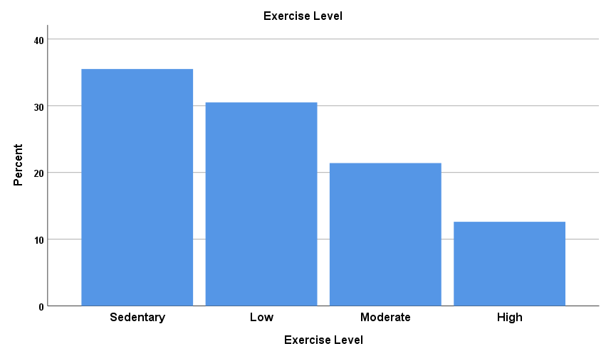
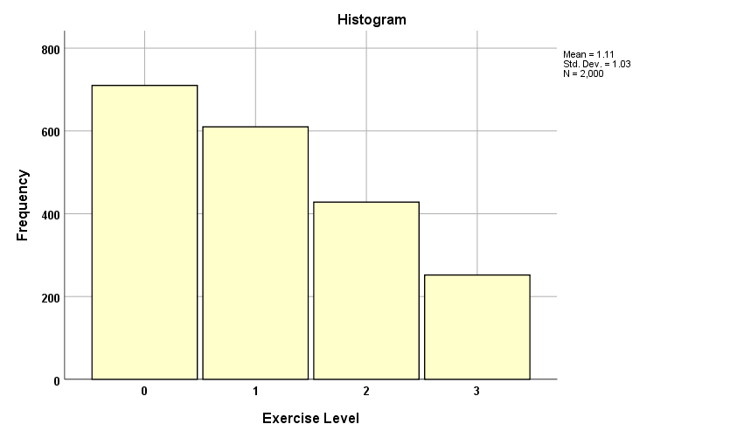
Which Analysis? Which Procedure?
Bar Chart
Frequencies Procedure
Histogram
Explore Procedure
Notes:
The Bar Chart we requested from the Frequencies procedure is on the left, and the Histogram from the Explore procedure is on the right.
Which is more informative? The BAR CHART! The histogram uses the numbers of the codes as the scale of 0 to 3.
So when we want to look at the distribution of a Categorical variable we use the Frequencies procedure, and when we want to look at the distribution of a Metric variable we use the Explore procedure.
Even if you produce the wrong output initially, you should be able to tell that you’ve used the incorrect procedure. If you can’t make sense of it, then you’ve probably chosen the wrong one!
We’ll have more practice in the tutorials this week with producing output in SPSS – so we’ll leave it here for now …

Slide 61
Now What?
Learning Outcomes
Each week there will be intended Learning Outcomes. By the end this week make sure you:
understand how proportions and percentages are calculated
understand how central tendency is measured and calculated
understand how to describe and summarise a categorical and metric variable
can identify a categorical and metric variable in SPSS
can produce and interpret output for categorial and metric variables in SPSS
Attend the Weekly Tutorial

Slide 62

Bombay, Tambo & Tabitha March 17 2022

